Slide 1

Spring ORM
Hibernate

Slide 2
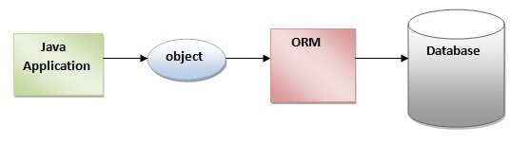
Spring ORM :-
ORM stands for "Object to Relational Mapping" where
● The Object part is the one you use with your programming language.
● The Relational part is a Relational Database Management System i.e., database
● And finally, the Mapping part is where you do a bridge between your objects and your tables.
So in other words, Object-Relational Mapping (ORM) is a technique that lets you query and manipulates data from a database using an object-oriented paradigm. And we can perform this mapping either through XML configuration or Annotations.
There are some other ORM tools - TopLink, EclipseLink, OpenJPA and iBatis.
Hibernate internally makes use of JDBC APIs to establish connections with the database. It makes the job easier.

Slide 3
Introduction to Hibernate :-
Hibernate is a Java framework that simplifies the development of Java application to interact with the database.
It was started in 2001 by Gavin King as an alternative to EJB2 style entity bean.
It is an open source, lightweight, ORM (Object Relational Mapping) tool.
Hibernate implements the specifications of JPA (Java Persistence API) for data persistence.
Hibernate is an object-relational mapping tool that is going to simplify the java application interaction with the Database.
It provides the facility to map the java classes to relational database tables and Java data types to SQL data types.
That means using hibernate we can simplify the java development effort to talk to the database.

Slide 4
Spring integration with Hibernate -
Some simple steps for creating hibernate application with spring integration:
Create Java Project with both Spring [including ORM] and Hibernate Libraries.
2.Create Bean/POJO class.
create Employee.java file
3. Prepare Hibernate Mapping File
create employee <classname>.hbm.xml file
4. Create DAO interface with persistence methods.
5. Create DAO implementation class with HibernateTemplate as property.
create EmployeeDao.java file
6. Prepare Spring Configuration File
7.Prepare Complete Application

Slide 5
Associations in Hibernate :-
the relationship that can be established between two entities are
●one to one —You need an entity attribute that represents the association, so annotate it with an @OneToOne annotation..
Transaction -> Customer
● one to many- In this type of association, one object can be associated with multiple/different objects.
● many to one —In this association, many objects are associated with single objects.
Employee -> Address
● many to many — Many-to-Many mapping requires an entity attribute and a @ManyToMany annotation.
It can either be unidirectional and bidirectional.
Cart -> items

Slide 6
Hibernate Annotations :-
1. @Entity annotation
The @Entity annotation is used to specify that a Java class is an entity that can be persisted to a database. An entity class represents a table in a relational database.
@Entity public class Employee { // class definition }
2. @Table Annotation
The @Table annotation is used to specify that instances of the class should be stored in a database table named “employees”.
@Entity @Table(name = "employees") public class Employee { // class definition }

Slide 7
3. @Id Annotation
The @Id annotation is used to specify the primary key of the entity. Each entity class must have a primary key that uniquely identifies each row in the table.
@Entity @Table(name = "employees") public class Employee { @Id private Long id; // other fields and methods }
4. @Column Annotation
The @Column annotation is used to specify the attributes of a column in the database table. It can be used to customize the database column by specifying attributes such as the name, length, nullable, unique, and precision of the column.
@Entity
@Table(name = "company")
public class Company implements Serializable
{ @Column(name = "name")
private String name;
}

Slide 8
Hibernate Architecture :- The main elements in a Hibernate Architecture.
SessionFactory – Holds a second-level cache of data and provides the factory method to get session objects and clients of ConnectionProvider.
Session – A short-lived object which acts as an interface between database data and the java application objects. It has first-level cache of data and can be used to generate query, transaction, and criteria objects.
Transaction – It is an optional element of the Hibernate Architecture and specifies the atomic unit of work and has methods that are useful for transaction management.
ConnectionProvider – It is an optional element and provides an abstraction to the application from DriverManager.
TransactionFactory – Again an optional element. It is a factory of transaction objects.

Slide 9
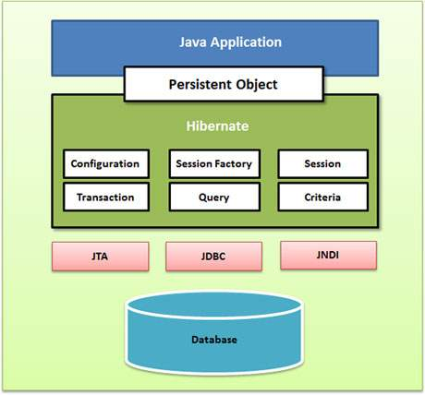

Slide 10
Core interfaces of Hibernate :-
The five core interfaces are used in every Hibernate application.
Session interface: This is the primary interface used by hibernate applications. The instance of this interface are lightweight and are inexpensive to create and destroy. Hibernate sessions are not thread-safe.
Session Factory interface: This is a factory that delivers the session objects to hibernate applications. Generally, there will be a single SessionFactory for the whole application and it will be shared among the application threads.
Configuration interface: This interface is used to configure and bootstrap hibernate. The instance of this interface is used by the application in order to specify the location of hibernate-specific mapping documents.
Transaction interface: This is an optional interface but the above three interfaces are mandatory in each and every application. This interface abstracts the code from any kind of transaction implementation such as a JDBC transaction.
Query and criteria interface: This interface allows the user to perform queries and also control the flow of the query execution.

Slide 11
Advantages of Hibernate Framework over JDBC -
1) Open Source and Lightweight
2) Fast Performance
3) Database Independent Query
4) Automatic Table Creation
5) Simplifies Complex Join

Slide 12
Thank You !!

